Slide 1
Ch.2 Random Variable (확률변수)
Updated: September 27, 2016
Choi, Kwanghoon
Dept. of Electronics and Computer Engineering
Chonnam National University

Slide 2
This Lecture
Random variables(확률 변수)
(Discrete/Continuous) Random variable
Probability mass/density function
Expected value, Variance

Slide 3
2.1 Discrete Random Variable (이산확률변수)
A random variable X is a function mapping each outcome into a numeral result.
E.g., in the sample space of three power plants,
0: idle
1: generating electricity
S
001
101
100
0.04
0.18
010
0.16
000
0.03
110
011
111
0.21
0.07
0.18
0.13
X :
Numerical
Results (S_{X})
0
1
2
3
=> discrete

Slide 4
2.1 Discrete Random Variable (이산확률변수)
A random variable X in the previous slide can also be described as:
X(000) = 0
X(001)=1, X(010)=1, X(100)=1
X(011)=2, X(101)=2, X(110)=2
X(111)=3
“X=1” denotes { z | X(z)=1 }
{001, 010, 100}
Event : “One plant is generating electricity.”

Slide 5
2.1 Discrete Random Variable (이산확률변수)
Activity1:
P(X=0)=?
P(X=1)=?
P(X=2)=?
P(X=3)=?
P(X≤1)=?

Slide 6
2.1 Discrete Random Variable (이산확률변수)
In the previous slide, what we have done is:
S
001
101
100
0.04
0.18
010
0.16
000
0.03
110
011
111
0.21
0.07
0.18
0.13
X :
Numerical
Results (S_{X})
Probability
Mass Function :
(p.m.f)
0
1
2
3
0.07
0.04+0.03+0.16
0.18+0.18+0.21
0.13
probability

Slide 7
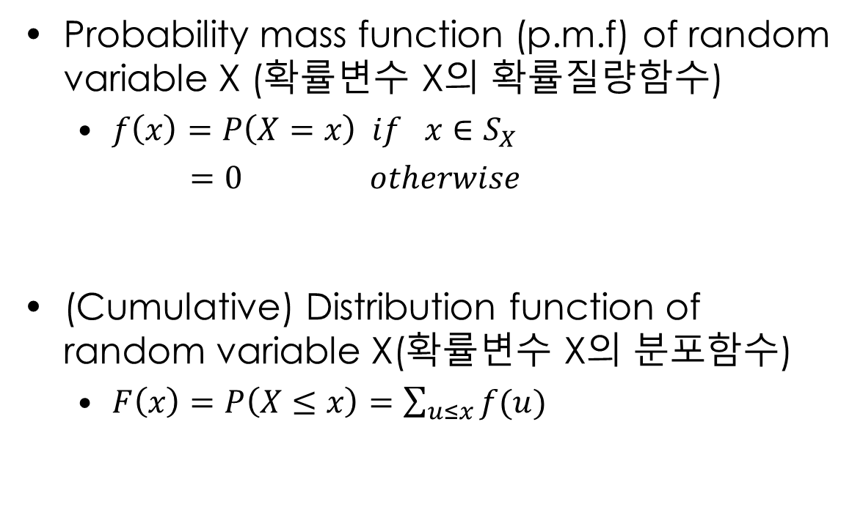
2.1 Discrete Random Variable (이산확률변수)
(*) Distribution(분포)
Probability mass function (p.m.f) of random variable X (확률변수 X의 확률질량함수)
$f\left(x\right)=P\left(X=x\right) if x∈S_{X}$
$=0 otherwise$
(Cumulative) Distribution function of random variable X(확률변수 X의 분포함수)
$F\left(x\right)=P\left(X≤x\right)=\sum_{u≤x}{f(u)}$
cf. Properties of p.m.f (교재 슬라이드 P.6)

Slide 8
2.1 Discrete Random Variable (이산확률변수)
Activity2:
Write a probability mass function (p.m.f) of random variable X in the power plant problem.
Activity3:
Write a distribution function of random variable X in the power plant problem.

Slide 9
2.2 Continuous Random Variable (연속확률변수)
Comparison
Discrete random variable (이산확률변수) | Continuous random variable (연속확률변수)
The random variable values are discrete. | The random variable values are continuous.
P.m.f (probability mass function, 확률질량함수) – distribution | P.d.f (probability density function, 확률밀도함수) – distribution
Distribution function (분포함수) | Distribution function (분포 함수)

Slide 10
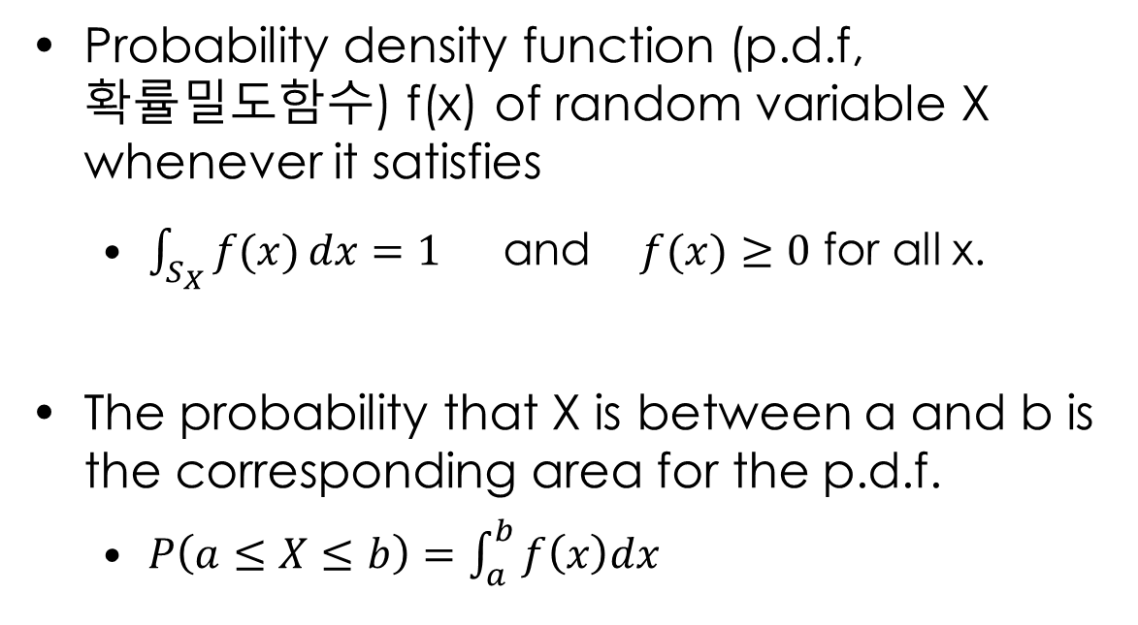
2.2 Continuous Random Variable (연속확률변수)
(*) Distribution(분포)
Probability density function (p.d.f, 확률밀도함수) f(x) of random variable X whenever it satisfies
$\int_{S_{X}}{f(x)}dx=1$ and $f(x)≥0$ for all x.
The probability that X is between a and b is the corresponding area for the p.d.f.
$P\left(a≤X≤b\right)=\int_{a}^{b}{f\left(x\right)dx}$

Slide 11

2.2 Continuous Random Variable (연속확률변수)
(*) Distribution(분포)
(Cumulative) Distribution function of random variable X(확률변수 X의 분포함수)
$F\left(x\right)=P\left(X≤x\right)=\int_{−∞}^{x}{f\left(u\right)du}$

Slide 12
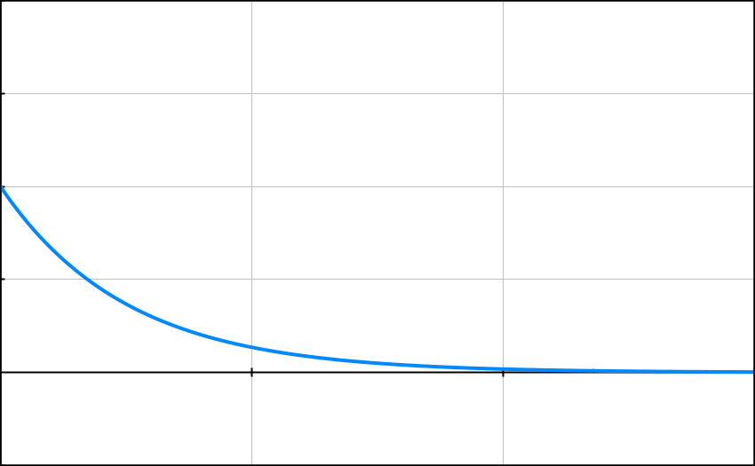

2.2 Continuous Random Variable (연속확률변수)
Activity1: 예제1
What is k for f(x) to be a p.d.f.?
Calculate P(1<X<=2).
Calculate P(X>=1.5).
f(x)
$$f\left(x\right)=ke^{−2x} for x≥0$$
k
0
x

Slide 13
2.2 Continuous Random Variable (연속확률변수)
Activity2: 예제2
Calculate a distribution function F(x) for p.d.f. f(x) in 예제1.
Calculate P(1<X<=2) and P(X>=1.5) again.

Slide 14
2.3 Expected Value (기댓값)
Complete information of probabilities
E.g., Probability mass/density functions
Summary measures of probabilistic properties
Expected value (기댓값)
Variance(분산), Standard deviation(표준편차)
Median(중앙값)
Mode(최빈값, 가장 빈번한 값)
Quatiles(사분위수), Percentile(백분위수)

Slide 15

2.3 Expected Value (기댓값)
The expected value ($μ,$expectation) of a discrete/continuous random variable
$E\left(X\right)=\sum_{x∈S_{X}}{x P(X=x)}=\sum_{x∈S_{X}}{x f(x)}$
$E\left(X\right)=\int_{−∞}^{∞}{x f\left(x\right)dx}$

Slide 16
2.3 Expected Value (기댓값)
Activity1 (연습문제1). In a poker game, a person has a winning probability of 3/5. When he wins, he will get 40,000won. When he loses the game, he will lose 50,000won. What is the expected value of the game?

Slide 17
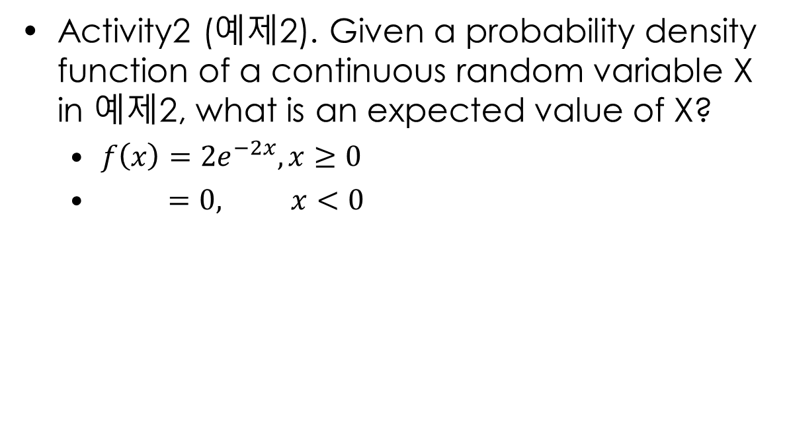
2.3 Expected Value (기댓값)
Activity2 (예제2). Given a probability density function of a continuous random variable X in 예제2, what is an expected value of X?
$f\left(x\right)=2e^{−2x}, x≥0$
$=0, x<0$

Slide 18
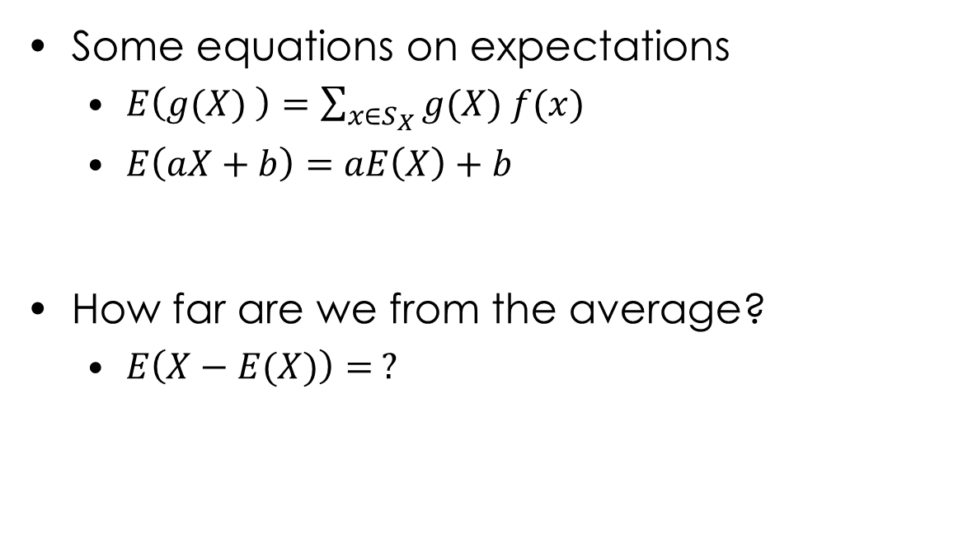
2.3 Expected Value (기댓값)
Some equations on expectations
$E\left(g(X) \right)=\sum_{x∈S_{X}}{g(X) f(x)}$
$E\left(aX+b\right)=aE\left(X\right)+b$
How far are we from the average?
$E\left(X−E(X)\right)= ?$

Slide 19
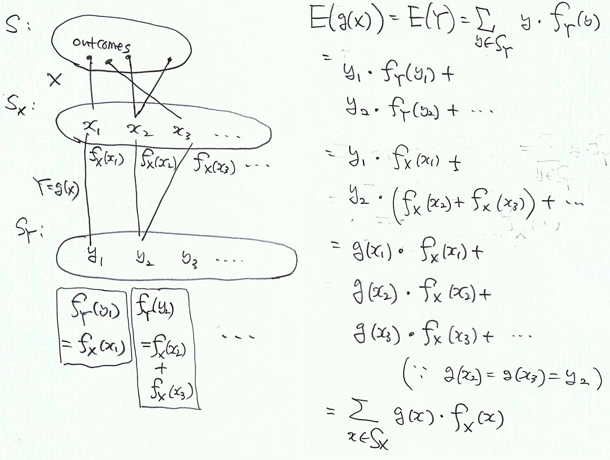
2.3 Expected Value (기댓값)

Slide 20
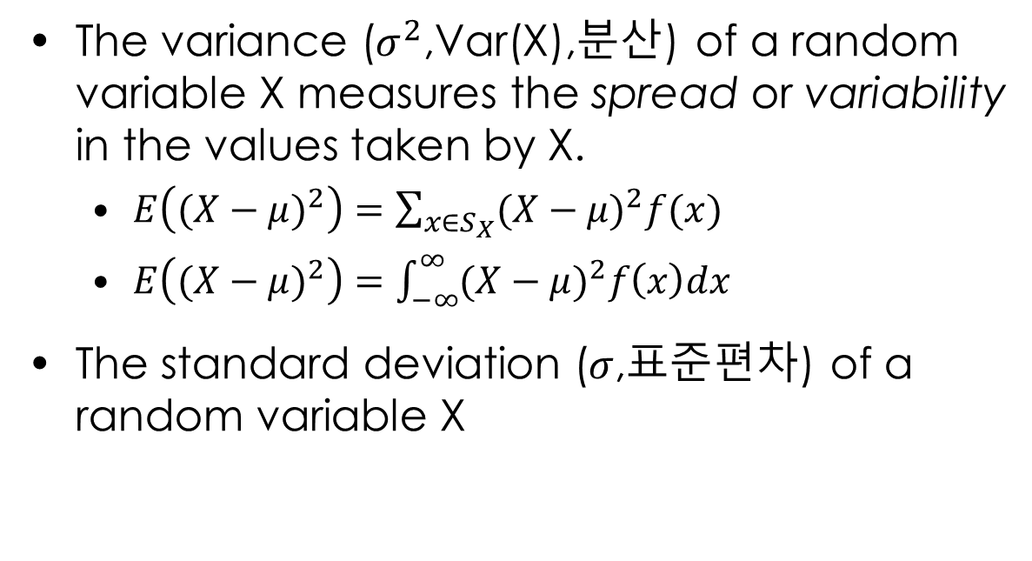
2.3 Expected Value (기댓값)
The variance ($σ^{2}$,Var(X),분산) of a random variable X measures the spread or variability in the values taken by X.
$E\left({(X−μ)}^{2}\right)=\sum_{x∈S_{X}}{{(X−μ)}^{2}f(x)}$
$E\left({(X−μ)}^{2}\right)=\int_{−∞}^{∞}{{(X−μ)}^{2}f\left(x\right)dx}$
The standard deviation ($σ$,표준편차) of a random variable X

Slide 21
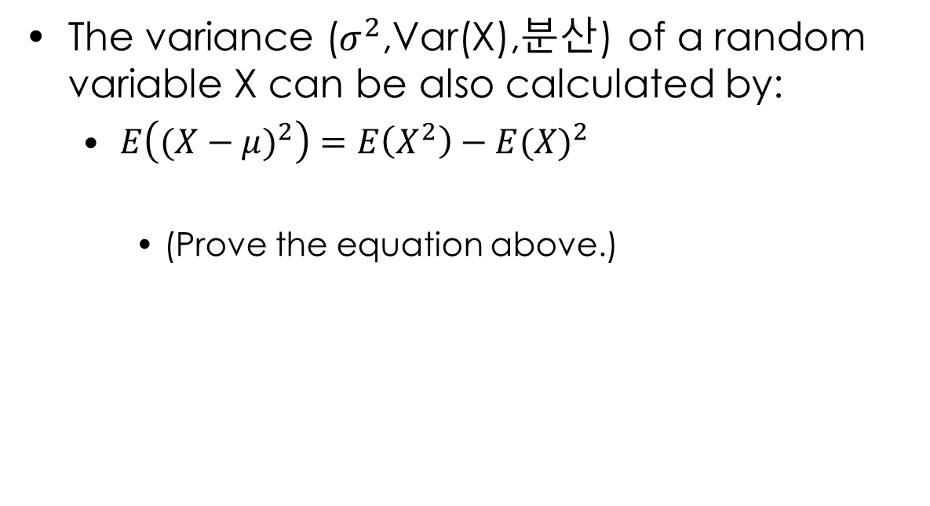
2.3 Expected Value (기댓값)
The variance ($σ^{2}$,Var(X),분산) of a random variable X can be also calculated by:
$E\left({(X−μ)}^{2}\right)=E\left(X^{2}\right)−{E(X)}^{2}$
(Prove the equation above.)

Slide 22

2.3 Expected Value (기댓값)
Activity3: In a travel of a 200 km distance at constant but random speed V,
E(V) =
Var(V)=
${\text{σ}}_{V}$
f(v)
1/2
1/2
v (km/h)
1
200

Slide 23
2.3 Expected Value (기댓값)
Activity3: In a travel of a 200 km distance at constant but random speed V,
T : a random variable for Time in hours
E(T) =
E(TV)= E(T)E(V)=
E(200/V)= 200/E(V)=
f(v)
1/2
1/2
v (km/h)
1
200

Slide 24
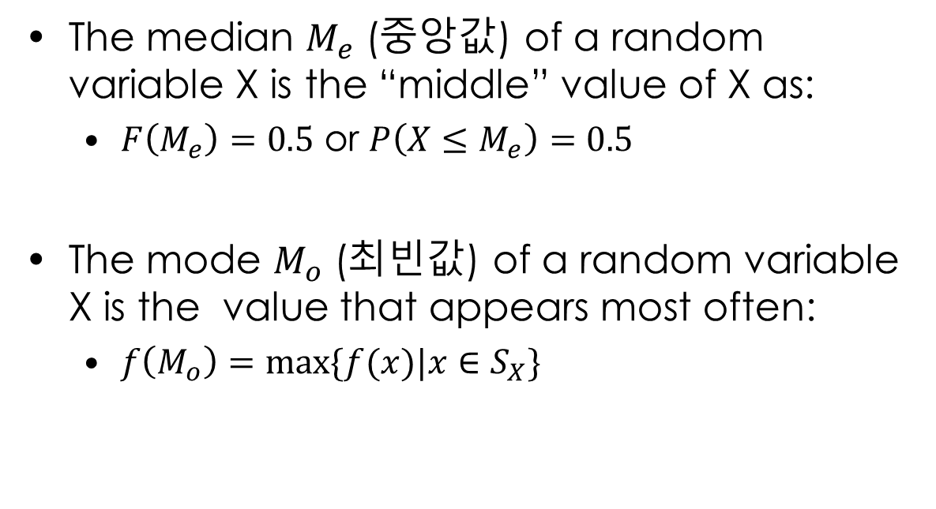
2.3 Expected Value (기댓값)
The median $M_{e}$ (중앙값) of a random variable X is the “middle” value of X as:
$F\left(M_{e}\right)=0.5$ or $P\left(X≤M_{e}\right)=0.5$
The mode $M_{o}$ (최빈값) of a random variable X is the value that appears most often:
$f\left(M_{o}\right)=max⁡\{f(x)|x∈S_{X}\}$

Slide 25
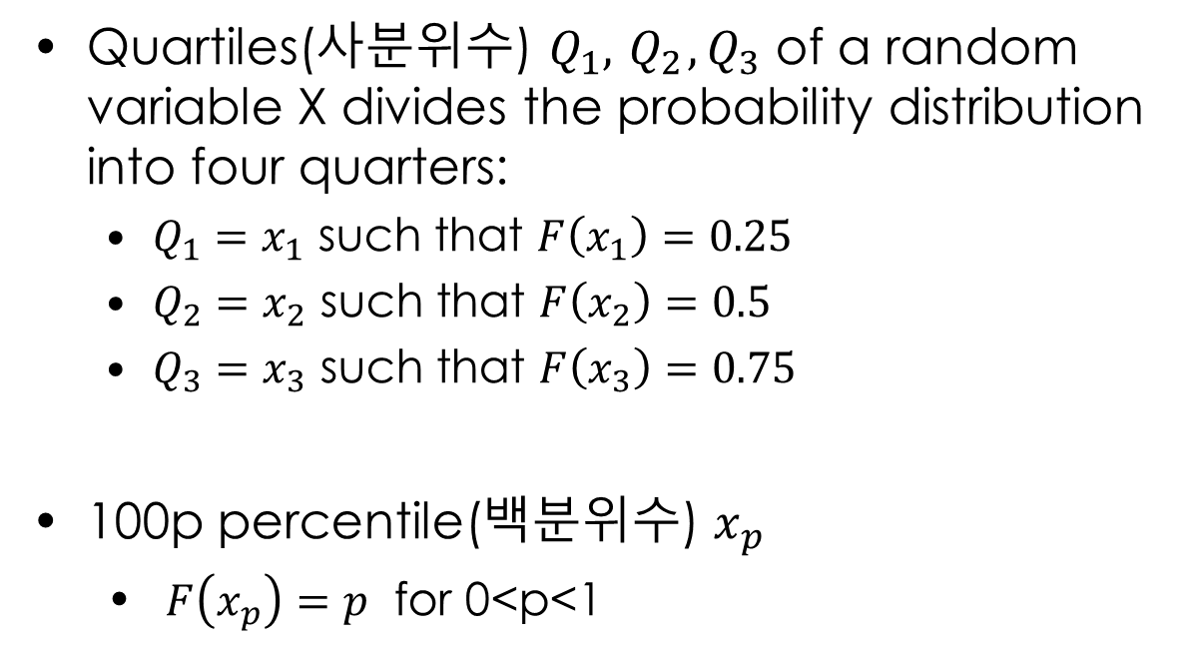
2.3 Expected Value (기댓값)
Quartiles(사분위수) $Q_{1},{ Q}_{2},Q_{3}$ of a random variable X divides the probability distribution into four quarters:
$Q_{1}=x_{1}$ such that $F\left(x_{1}\right)=0.25$
$Q_{2}=x_{2}$ such that $F\left(x_{2}\right)=0.5$
$Q_{3}=x_{3}$ such that $F\left(x_{3}\right)=0.75$
100p percentile(백분위수) $x_{p}$
$F\left(x_{p}\right)=p$ for 0<p<1

Slide 26
What we have learned
How to calculate probability using random variables
Random variables
P.M.F and P.D.F (Distribution of random variable)
Summary measures of probabilistic properties of a random variable

